Slide 1
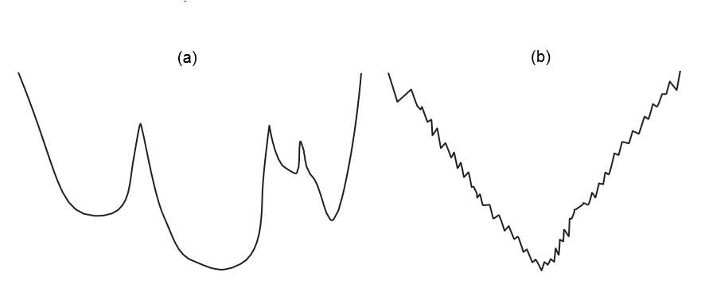

1-dimensional Ordered Examples
Suppose you’re trying to find a local minimum on a 1-dimensional space that looks like this:
Which method would most easily find the global minimum?
What happens in hundreds or thousands of dimensions?
What if different parts of the search space have different structure?

Slide 2
Stochastic Local Search
Stochastic local search is a mix of:
Greedy descent: move to a lowest neighbor
Random walk: taking some random steps
Random restart: reassigning values to all variables

Slide 3
Random Walk
Variants of Random Walk:
When choosing the best variable-value pair, randomly sometimes choose a random variable-value pair.
When selecting a variable then a value:
Sometimes choose any variable that participates in the most conflicts
Sometimes choose any variable that participates in any conflict
Sometimes choose any variable
Sometimes choose the best value and sometimes choose a random value

Slide 4
Simple Iterative Best Improvement Example I
Consider a problem with four variables, {A,B,C,D}.
Each variable can take one of four values, {1,2,3,4}.
Find assignment of values to variables that meets constraints.
Constraints: A < B, B > C, A != C, B = D
We will start with a “random” assignment of values to variables and use a two-stage choice algorithm to find a satisfying assignment of the variables.
That is, identify the variable(s) that participates in the most conflicts.
Choose the value(s) of that variable that minimizes the number of conflicts for that variable.
Repeat until no conflicts.

Slide 5
Simple Iterative Best Improvement Example II
Random initial assignment is A=3, B=1, C=2, D = 1
Constraints: A < B, B > C, A != C, B = D
“Eval” is total conflicts
B participates in most conflicts, change it. Dom(B) = {1,2,3,4}
Best value for B is 4
Now I have to change B or D.
A | B | C | D | Eval | Conf.A | Conf.B | Conf.C | Conf.D
3 | 1 | 2 | 1 | 2 | 1 | 2 | 1 | 0
A | B | C | D | Eval | Conf.A | Conf.B | Conf.C | Conf.D
3 | 1 | 2 | 1 | 2 | 1 | 2 | 1 | 0
3 | 4 | 2 | 1 | 1 | 0 | 1 | 0 | 1

Slide 6
Simple Iterative Best Improvement Example III
One could say “obviously it’s best to change D, not B”
But that requires thinking, which may take too long in Local Search. It can be better to just quickly, randomly choose.
Suppose we choose to change “B” to 1. We cycle.
If we keep a Tabu list, this is disallowed and so we have to change D to 4.
A | B | C | D | Eval | Conf.A | Conf.B | Conf.C | Conf.D
3 | 1 | 2 | 1 | 2 | 1 | 2 | 1 | 0
3 | 4 | 2 | 1 | 1 | 0 | 1 | 0 | 1
3 | 1 | 2 | 1 | 2 | 1 | 2 | 1 | 0

Slide 7
Tabu Lists
To prevent cycling we can maintain a tabu list of the k last assignments.
Don’t allow an assignment that is already on the tabu list.
If k = 1, we don’t allow an assignment of the last different value to the variable chosen.
We can implement it more efficiently than as a list of complete assignments.
It can be expensive if k is large.

Slide 8
Simple Iterative Best Improvement Example IV
If we have a Tabu list, we cannot change B back to 1.
So we change D to 4 and we have no more conflicts.
A | B | C | D | Eval | Conf.A | Conf.B | Conf.C | Conf.D
3 | 1 | 2 | 1 | 3 | 1 | 2 | 1 | 0
3 | 4 | 2 | 1 | 1 | 0 | 1 | 0 | 1
3 | 4 | 2 | 4 | 0 | 0 | 0 | 0 | 0

Slide 9
Recall: Planning Your Degree
Assume that you have a bachelor’s degree in something, with Math coursework up through precalculus.
So all you need to take are the required CS courses + Calculus and Discrete Math.
Math is green, ICS is blue.
You want to finish in 6 semesters.
Crse | 210 | 215 | 140 | 141 | 232 | 240 | 311 | 340 | 365 | 372 | 440 | 460 | 462 | 499

Slide 10
Recall: Random Beginning
To start local search, you could choose a random beginning.
Each number is a proposed semester, chosen randomly from 1 to 6.
This example isn’t totally random, to keep the number of conflicts manageable visually.
Strategy: Choose variable with most conflicts, and replace it with value that minimizes conflicts.
Crse | 210 | 215 | 140 | 141 | 232 | 240 | 311 | 340 | 365 | 372 | 440 | 460 | 462 | 499
Sem | 3 | 2 | 1 | 2 | 2 | 5 | 5 | 6 | 3 | 2 | 3 | 6 | 4 | 3

Slide 11
Identify Conflicts
Each row shows 1-3 conflicts, (items of same color)
Note some of these are major declaration conflicts
ICS 240 has the most conflicts (3)
Crse | 210 | 215 | 140 | 141 | 232 | 240 | 311 | 340 | 365 | 372 | 440 | 460 | 462 | 499
Sem | 3 | 2 | 1 | 2 | 2 | 5 | 5 | 6 | 3 | 2 | 3 | 6 | 4 | 3
Conf | 2 | 2 | 0 | 1 | 2 | 3 | 0 | 1 | 1 | 2 | 2 | 0 | 1 | 1

Slide 12
Change Value
Minimize existing conflicts with ICS 240 = 1.
This adds 2 new conflicts. (*)
Now Math 215 has the most conflicts.
Transitive prereqs
Crse | 210 | 215 | 140 | 141 | 232 | 240 | 311 | 340 | 365 | 372 | 440 | 460 | 462 | 499
Sem | 3 | 2 | 1 | 2 | 2 | 1 | 5 | 6 | 3 | 2 | 3 | 6 | 4 | 3
 |  |  |  | * |  | *
 |  | * |  |  |  | *
Conf | 2 | 3 | 0 | 2 | 2 | 2 | 0 | 1 | 1 | 1 | 2 | 0 | 0 | 1

Slide 13
Continue
Continue on like this, this time you’ll move Math 215 to semester 1 (which will solve a lot of problems).
Keep doing this until you find a solution with no conflicts, or give up.

Slide 14
Comparing Stochastic Algorithms
How can you compare three algorithms when
One solves the problem 30% of the time very quickly but doesn’t halt for the other 70% of the cases
One solves 60% of the cases reasonably quickly but doesn’t solve the rest
One solves the problem in 100% of the cases, but slowly?
Summary statistics, such as mean run time, median run time, and modal run time don’t make much sense

Slide 15
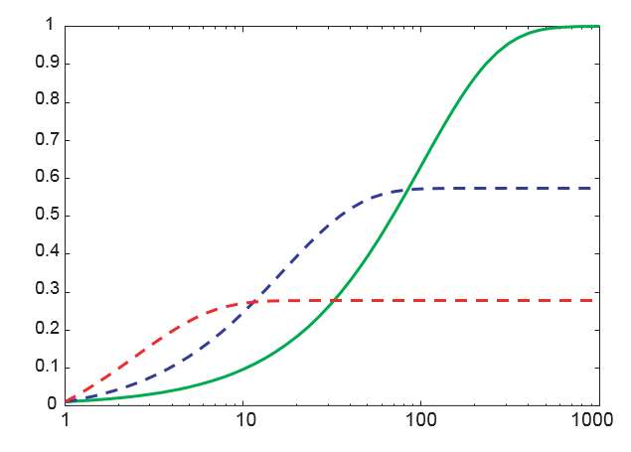
Runtime Distribution
Plots runtime (or number of steps) and the proportion (or number) of the runs that are solved within that runtime.

Slide 16
Variant: Simulated Annealing (I)
Pick a variable at random and a new value at random.
If it is an improvement, adopt it.
If it isn’t an improvement, adopt it probabilistically depending on a temperature parameter T.
Let h(n) be a measure of the goodness of assignment n
With current assignment n and proposed assignment n’ we move to n’ with probability

Slide 17
Variant: Simulated Annealing (II)
Temperature can be reduced
Sample probability of accepting a worse change
Temperature | 1-worse | 2-worse | 3-worse
10 | 0.91 | 0.81 | 0.74
1 | 0.37 | 0.14 | 0.05
0.25 | 0.02 | 0.0003 | 0.000006
0.1 | 0.00005 | 2 x 10⁻⁹ | 9 x 10⁻¹⁴

Slide 18
Parallel Search
A total assignment is called an individual
Idea: Maintain a population of k individuals instead of one.
At every stage, update each individual in the population.
Whenever an individual is a solution, it can be reported.
Like k restarts, but uses k times the minimum number of steps.

Slide 19
Beam Search
Like parallel search, with k individuals, but choose the k best out of all the neighbors.
When k = 1 it is greedy descent.
When k = ∞ it is breadth-first search.
The value of k lets us limit space and parallelism.

Slide 20
Stochastic Beam Search
Like beam search, but it probabilistically chooses the k individuals at the next generation.
The probability that a neighbor is chosen is proportional to its heuristic value.
This maintains diversity amongst the individuals.
The heuristic value reflects the fitness of the individual.
Like asexual reproduction: each individual mutates and the fittest ones survive.

Slide 21
Genetic Algorithms
Like stochastic beam search, but pairs of individuals are combined to create the offspring:
For each generation:
Randomly choose pairs of individuals where the fittest individuals are more likely to be chosen.
For each pair, perform a cross-over: form two offspring each taking different parts of their parents
Mutate some values.
Stop when a solution is found.

Slide 22
1-point Crossover
A common, simple way of doing crossover.
Given two individuals:
X₁ = a₁, X₂ = a₂, …, X_{m} = a_{m}
X₁ = b₁, X₂ = b₂, …, X_{m} = b_{m}
Select i at random.
Form two offspring:
X₁ = a₁, …, X_{i} = a_{i}, X_{i+1} = b_{i+1}, …, X_{m} = b_{m}
X₁ = b₁, …, X_{i} = b_{i}, X_{i+1} = a_{i+1}, …, X_{m} = a_{m}
The effectiveness depends on the ordering of the variables.
Many variations are possible.

Slide 23
Genetic Scheduling Example
Start with two “random” schedules
Cross over at a random point (I choose ICS 340) to create two new “child” schedules
Normally pick the best one(s) to propagate
Crse | 210 | 215 | 140 | 141 | 232 | 240 | 311 | 340 | 365 | 372 | 440 | 460 | 462 | 499
Sem | 3 | 2 | 1 | 2 | 2 | 5 | 5 | 6 | 3 | 2 | 3 | 6 | 4 | 3
Sem | 3 | 2 | 6 | 2 | 4 | 5 | 4 | 4 | 2 | 2 | 5 | 2 | 4 | 1
Crse | 210 | 215 | 140 | 141 | 232 | 240 | 311 | 340 | 365 | 372 | 440 | 460 | 462 | 499
Sem | 3 | 2 | 1 | 2 | 2 | 5 | 5 | 6 | 2 | 2 | 5 | 2 | 4 | 1
Sem | 3 | 2 | 6 | 2 | 4 | 5 | 4 | 4 | 3 | 2 | 3 | 6 | 4 | 3

